Slide 1
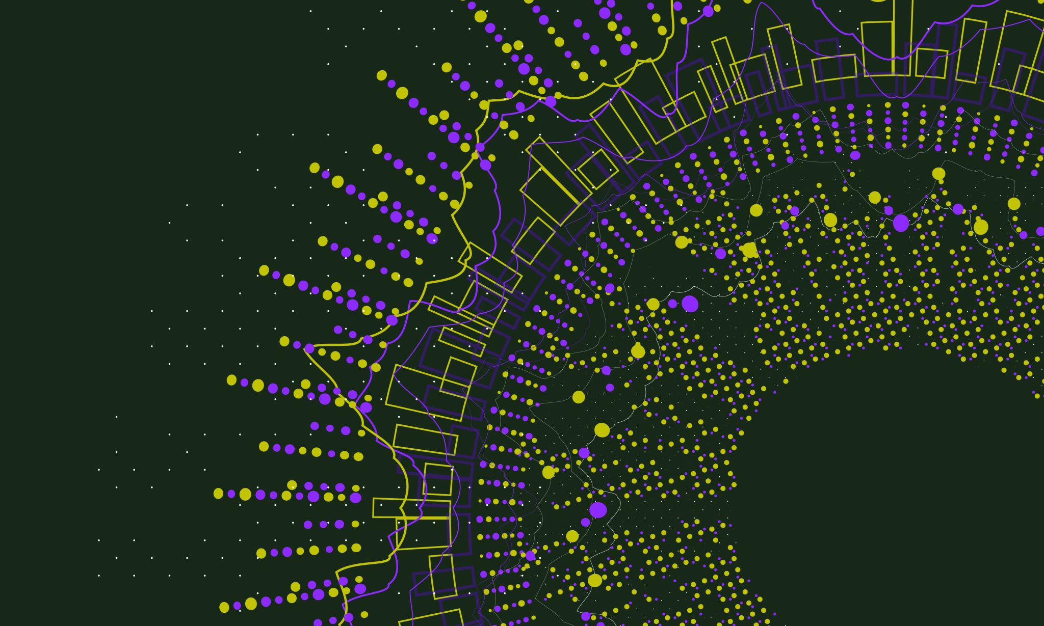
Natural Language Project using Google Cloud
Emre Beray Boztepe
350227

Slide 2

First Step:
New Project – ‘voltaic-day-407514’
Bucket Creation:
gsutil mb gs://cloud_computing_natural_language_bucket/
APIs:
Dataflow API
Google Natural Language API
BigQuery
Cloud Pub/Sub API

Slide 3
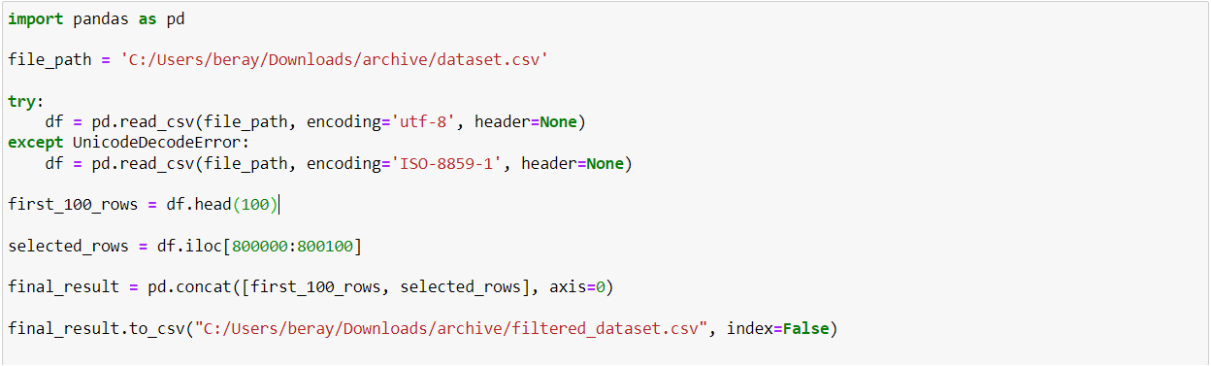
Data Set:
Link: https://www.kaggle.com/datasets/kazanova/sentiment140

Slide 4
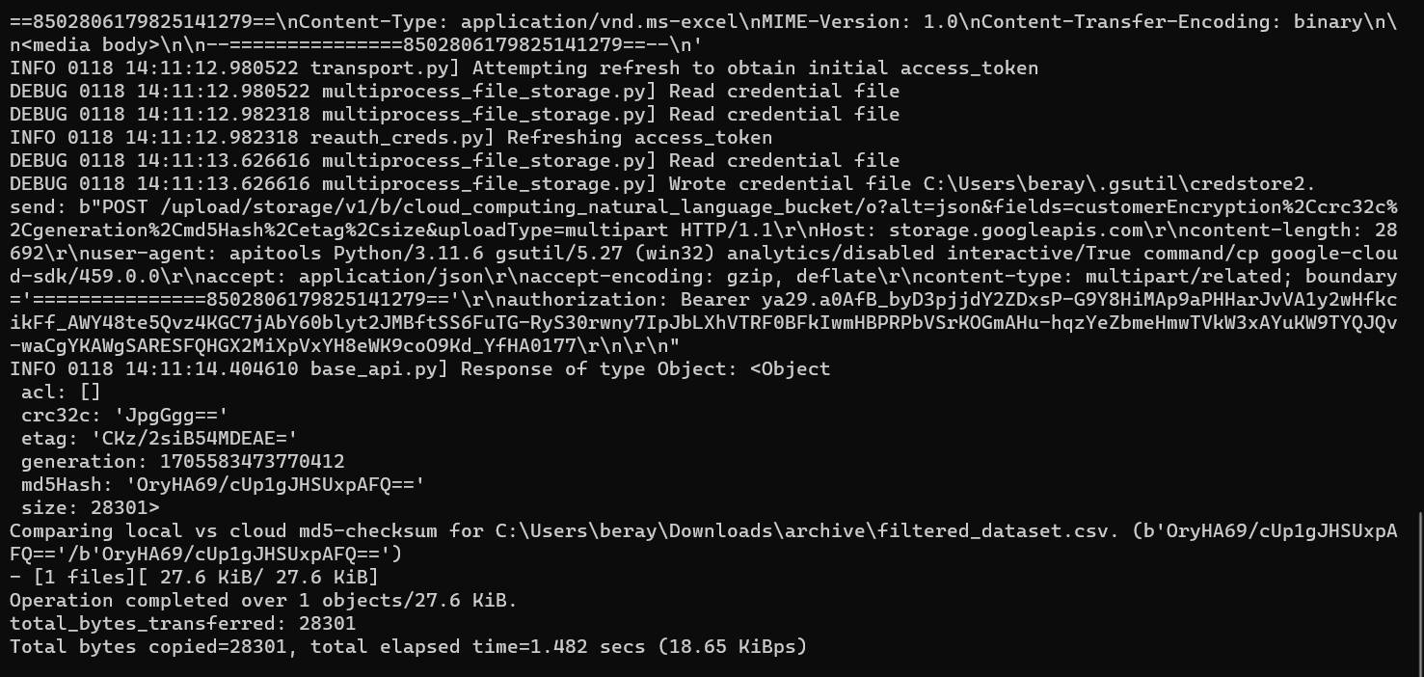
Upload Dataset to Bucket
gsutil -d cp C:\Users\beray\Downloads\archive\filtered_dataset.csv gs://cloud_computing_natural_language_bucket/
Google Cloud SDK
gcloud auth login

Slide 5
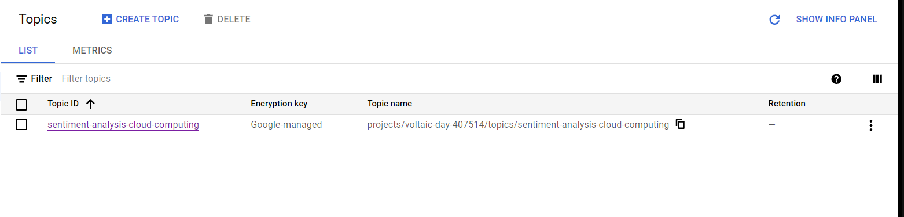
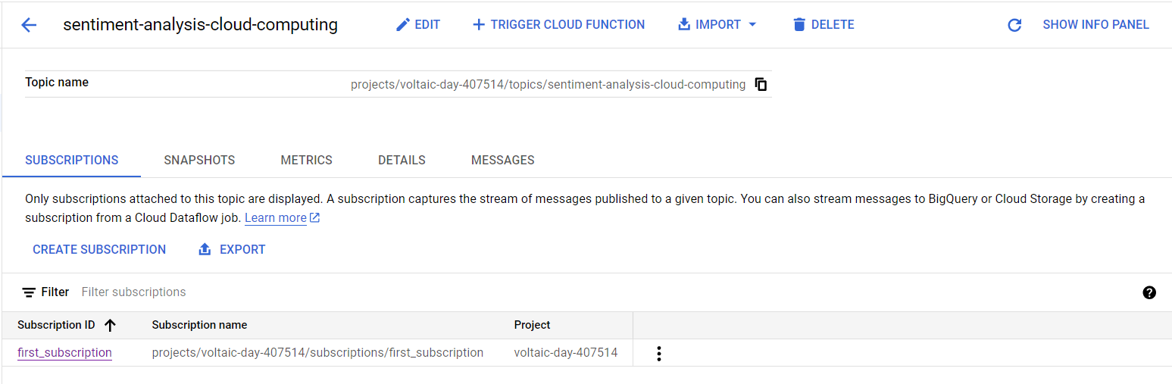
Creating Pub/Sub
gcloud pubsub topics create sentiment-analysis-cloud-computing
gcloud pubsub subscriptions create first_subscription --topic=sentiment-analysis-cloud-computing

Slide 6
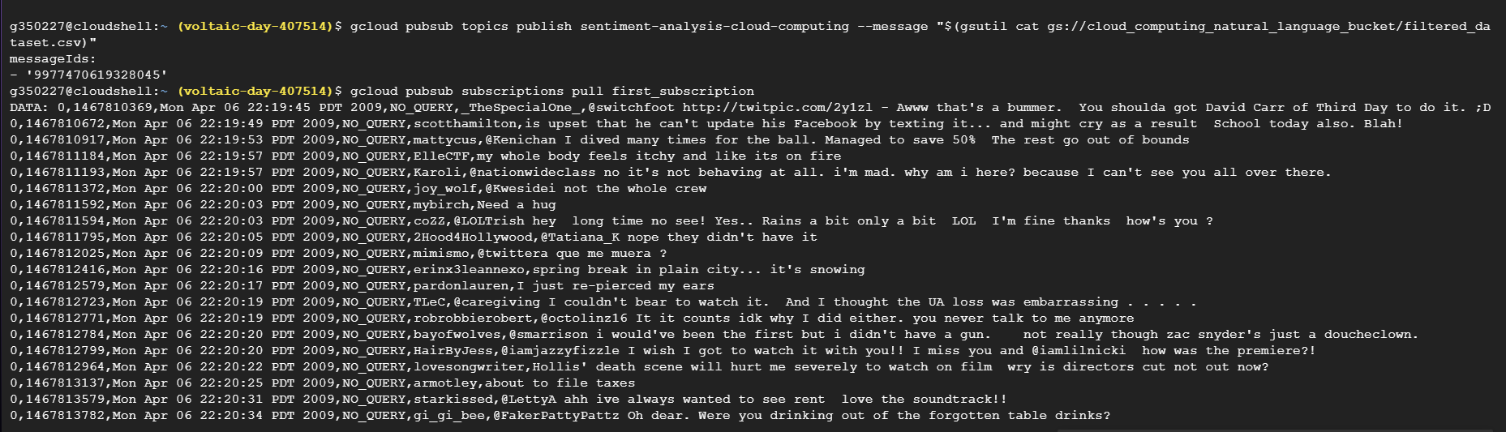
Using Pub/Sub
gcloud pubsub topics publish sentiment-analysis-cloud-computing --message "$(gsutil cat gs://cloud_computing_natural_language_bucket/filtered_dataset.csv)"

Slide 7
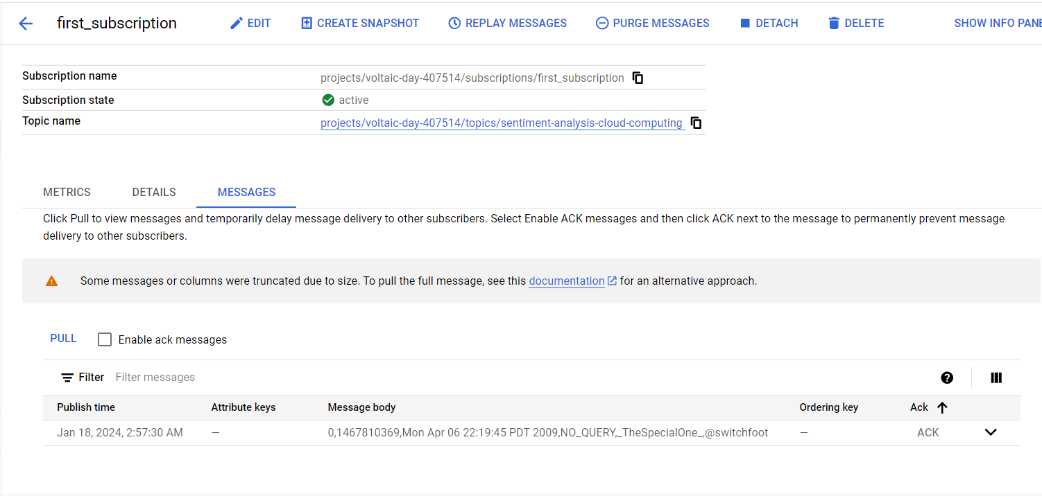

Slide 8
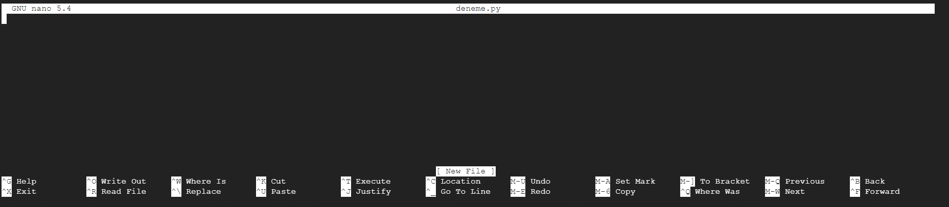
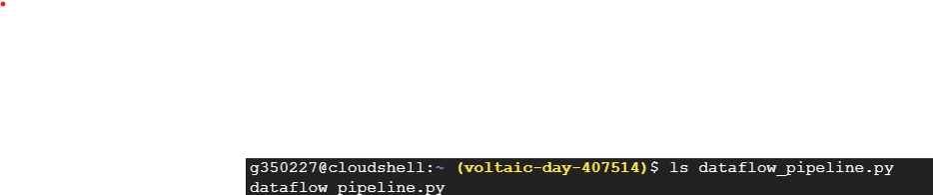
Python Code – Create py file
touch dataflow_pipeline.py
nano dataflow_pipeline.py
Nano interface

Slide 9
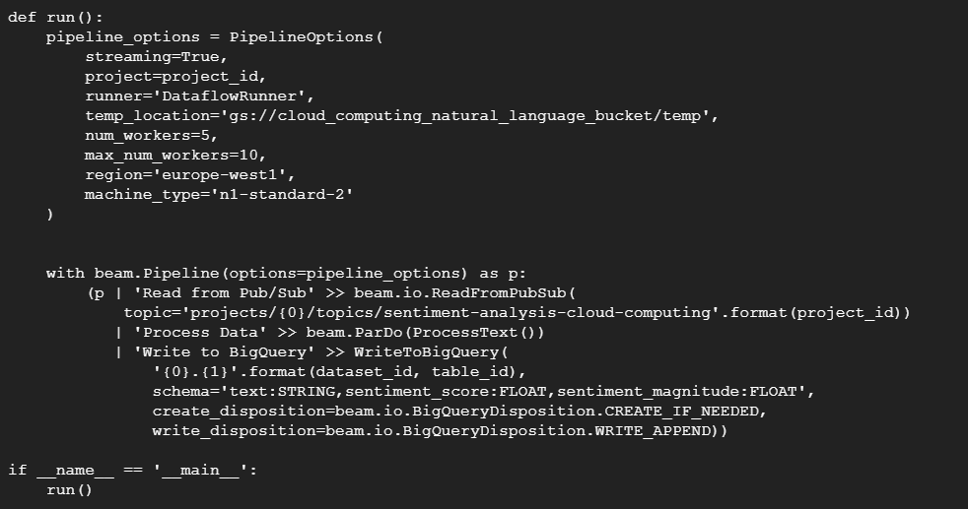
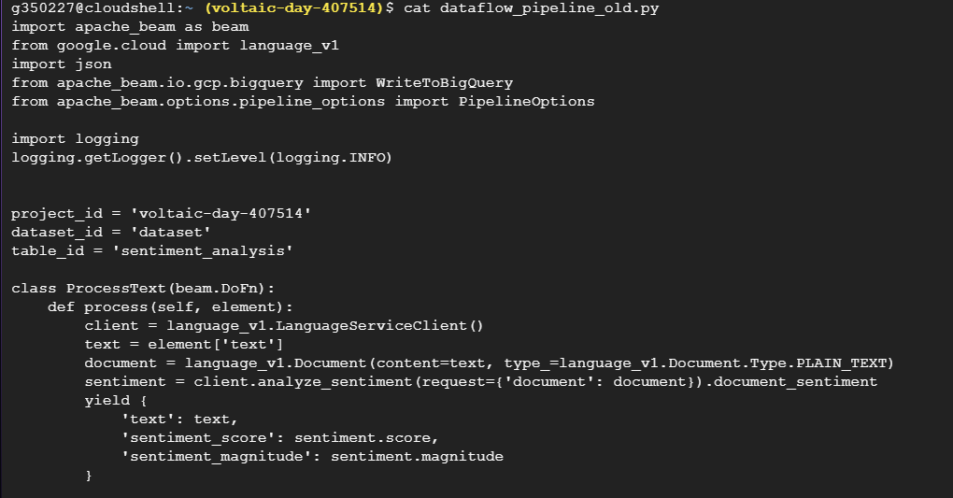
Python Code – Dataflow
pip install apache-beam[gcp] google-cloud-language google-cloud-pubsub

Slide 10
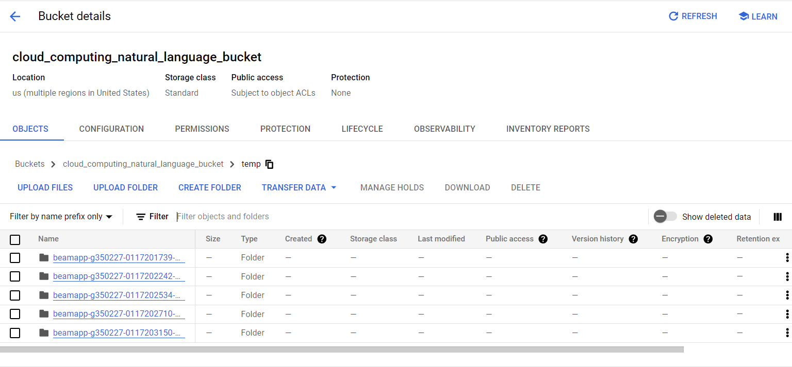
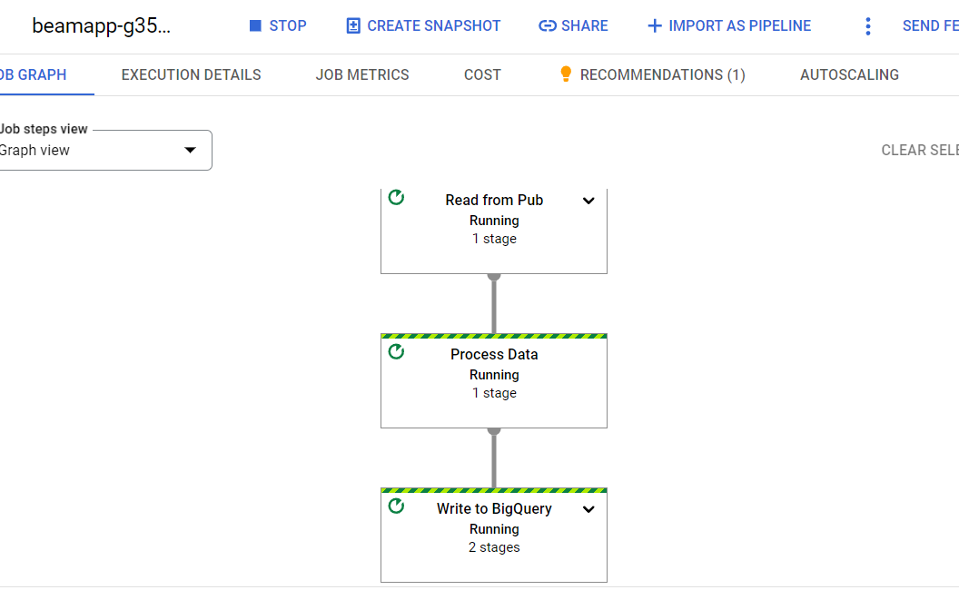
Pipeline

Slide 11
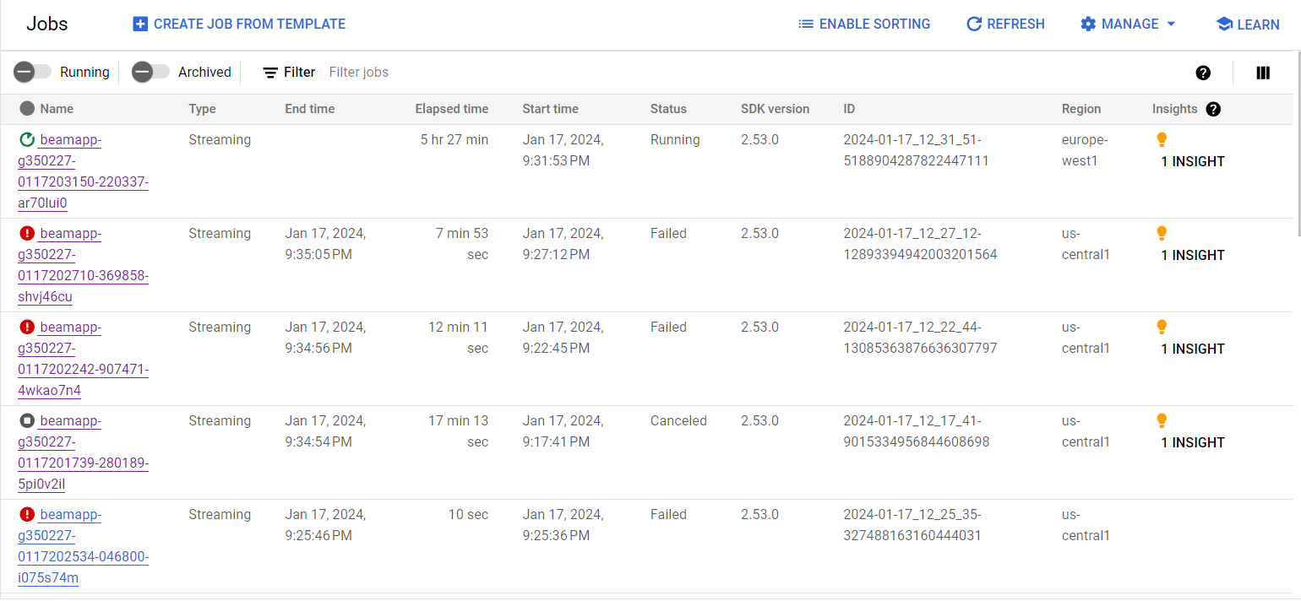
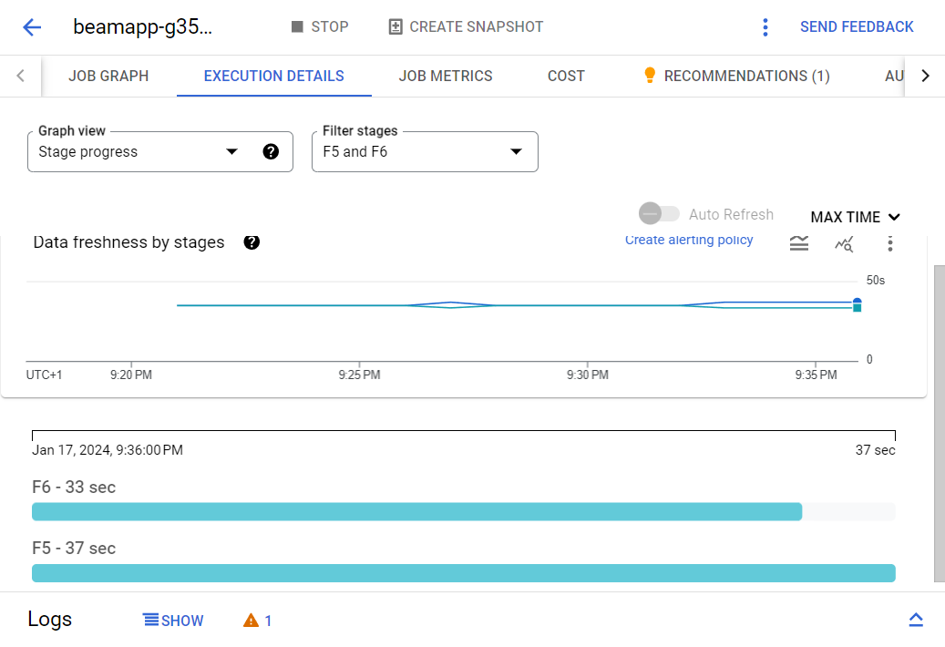

Slide 12
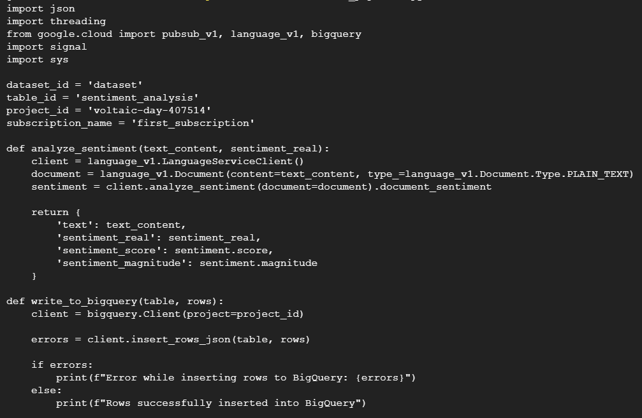
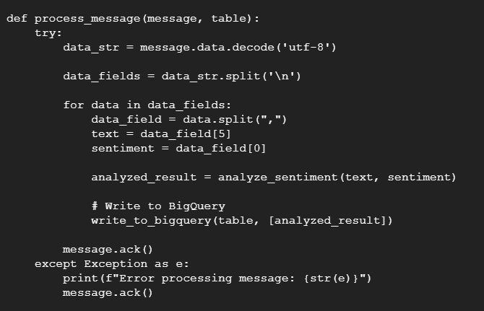

Slide 13

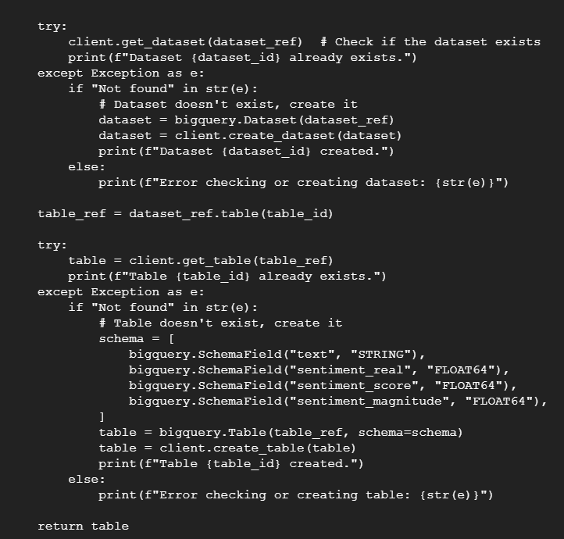
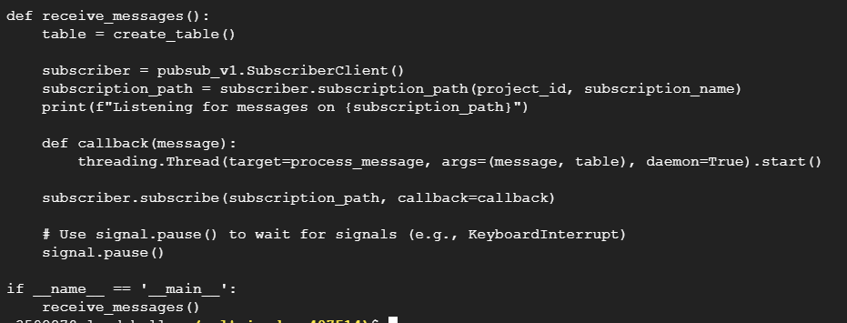

Slide 14

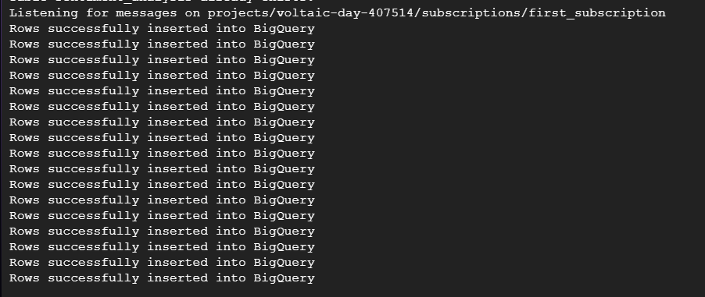
Run the code

Slide 15
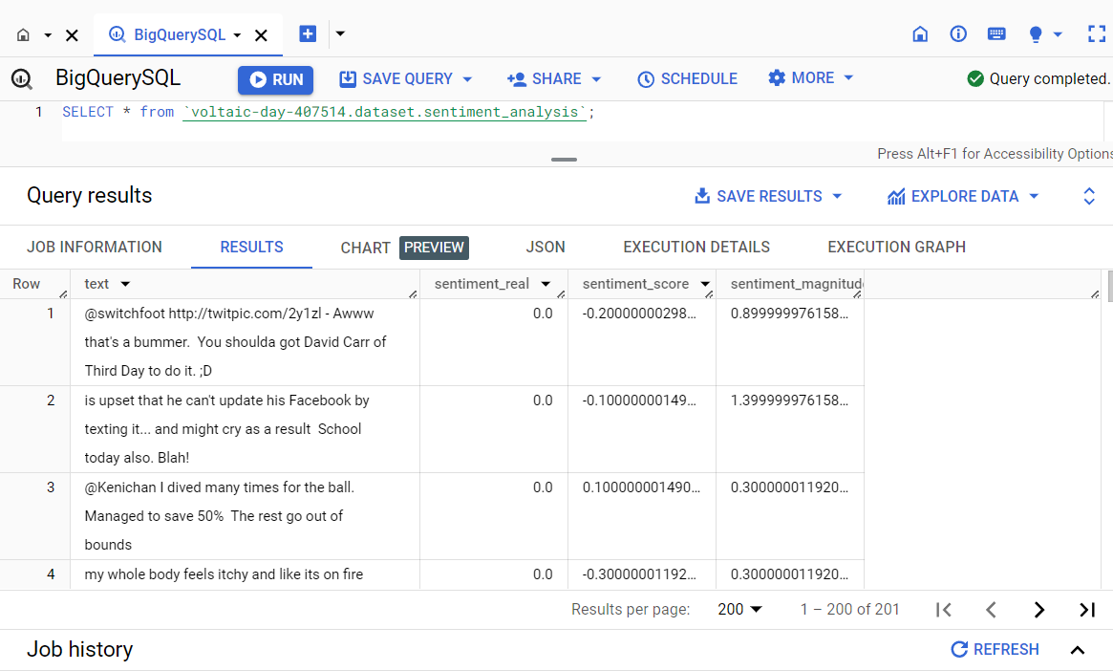
Result Analysis

Slide 16
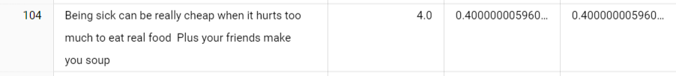
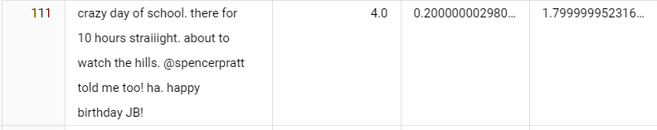
Positive Result Analysis

Slide 17

Negative Result Analysis

Slide 18
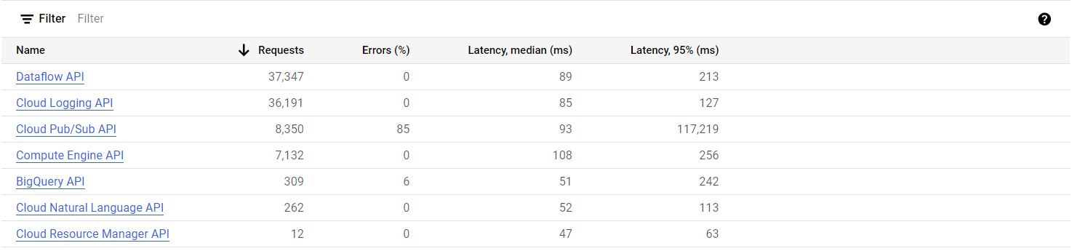
Cloud Analysis

Slide 19
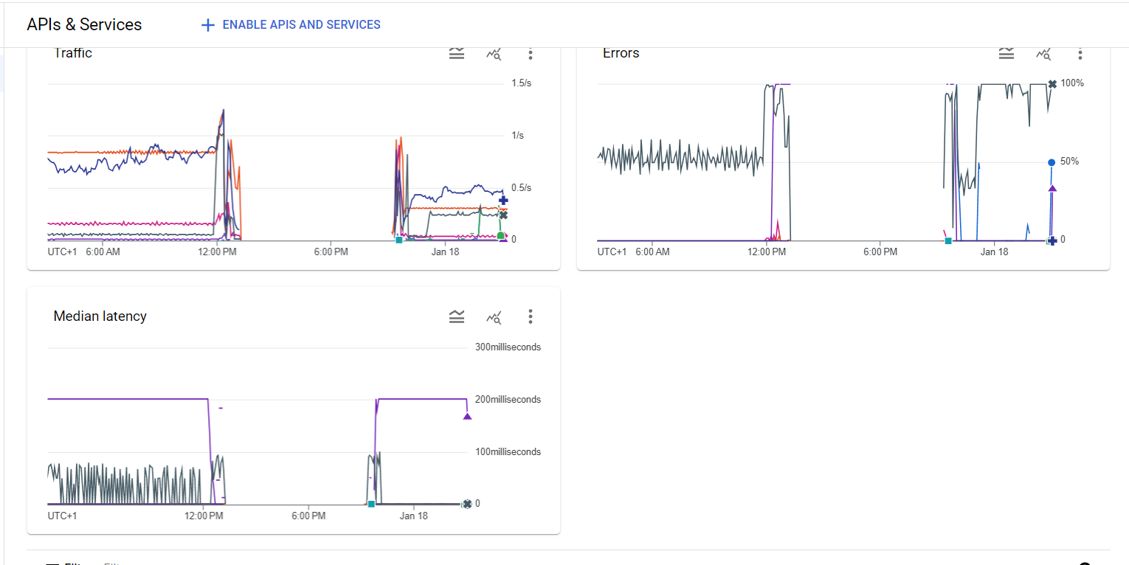

Slide 20
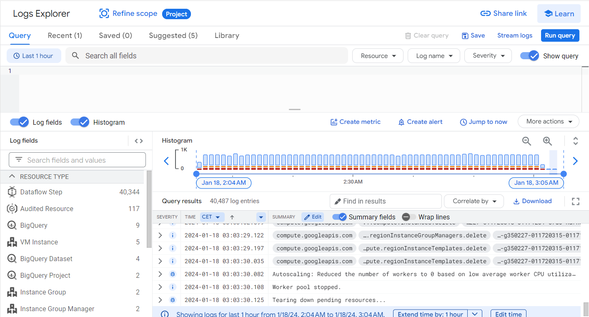

Slide 21

Thank you so much!

